Slide 1
TF-13 Fall Meeting
Recent TTI Research
William Williams, P.E.
Associate Research Engineer
Texas A&M Transportation Institute
College Station, Texas
September 27, 2013

Slide 2
TL-2 TXDOT Type T631 Bridge Rail

Slide 3
Objective
Design on a new bridge rail to meet the crash requirements of MASH TL-2
Perform full scale crash testing on the new design
Design needed for 8” Thick concrete deck and minimize deck damage crash loads

Slide 4
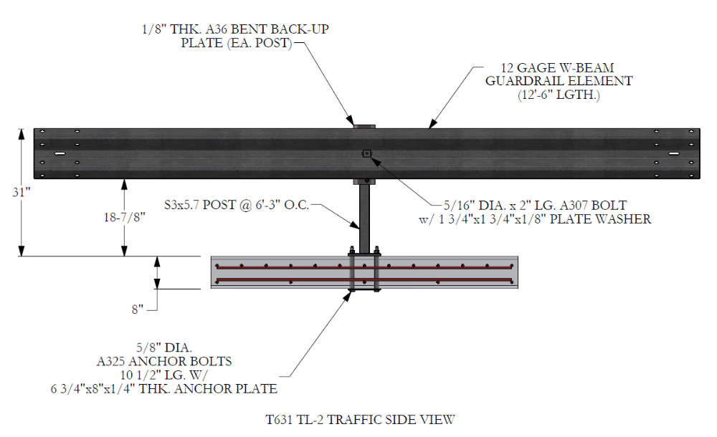
T631 Bridge Rail Design

Slide 5
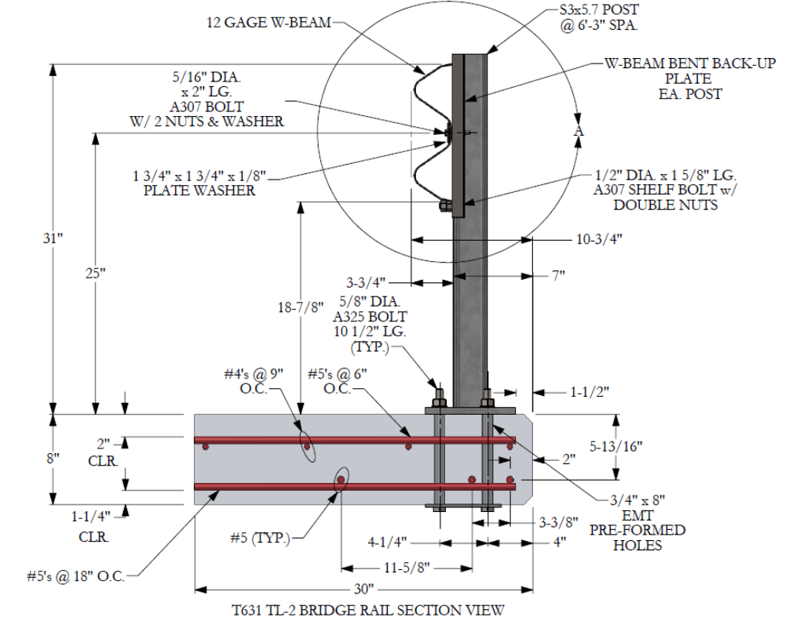

Slide 6
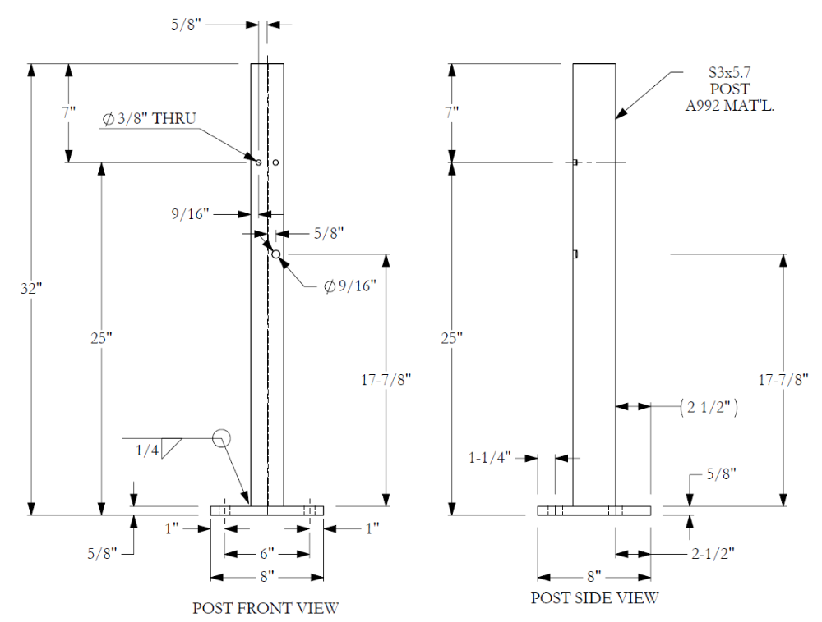

Slide 7
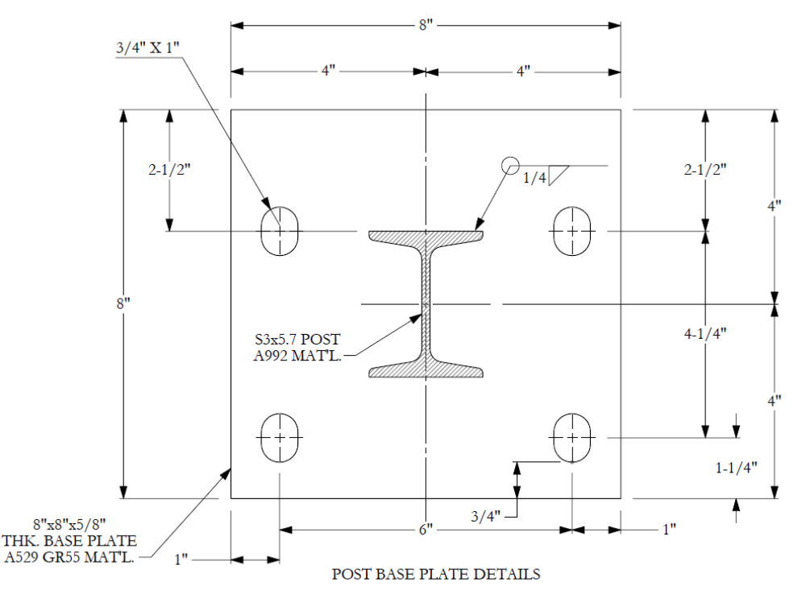

Slide 8
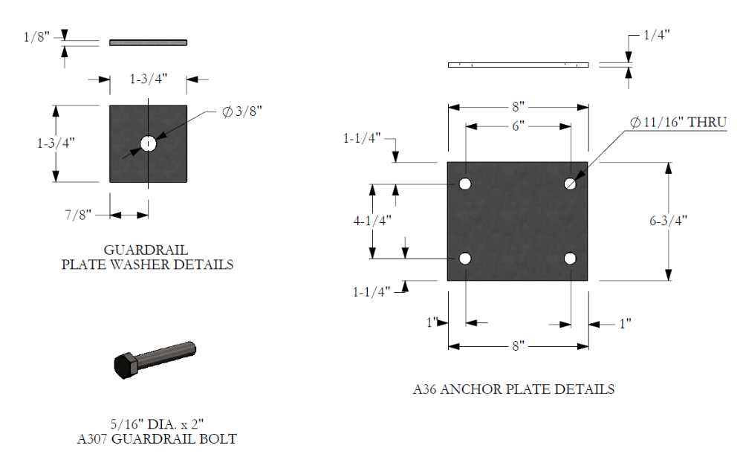

Slide 9
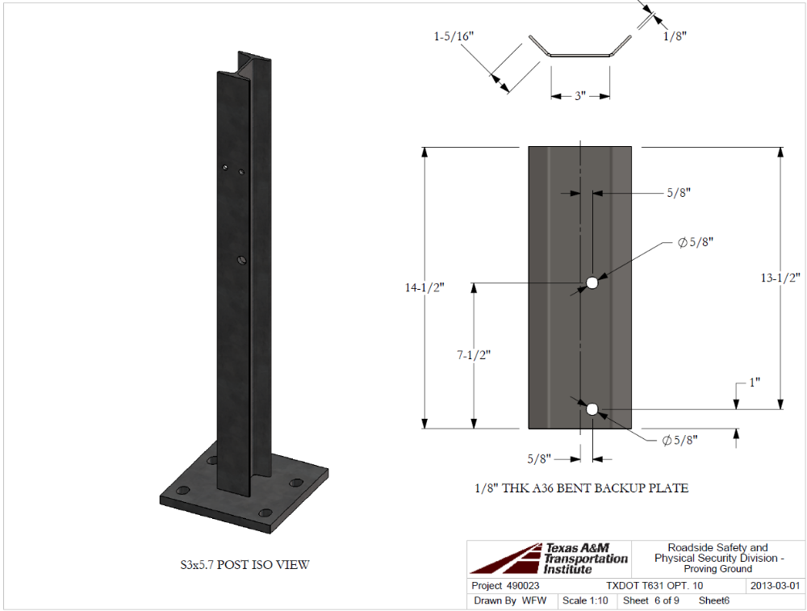

Slide 10
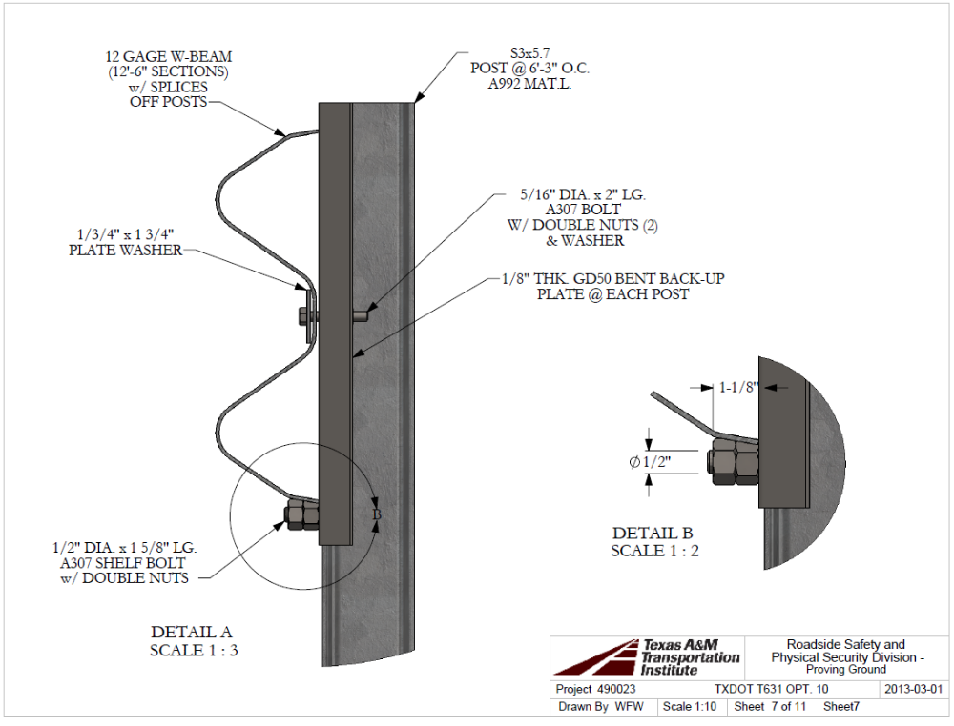

Slide 11
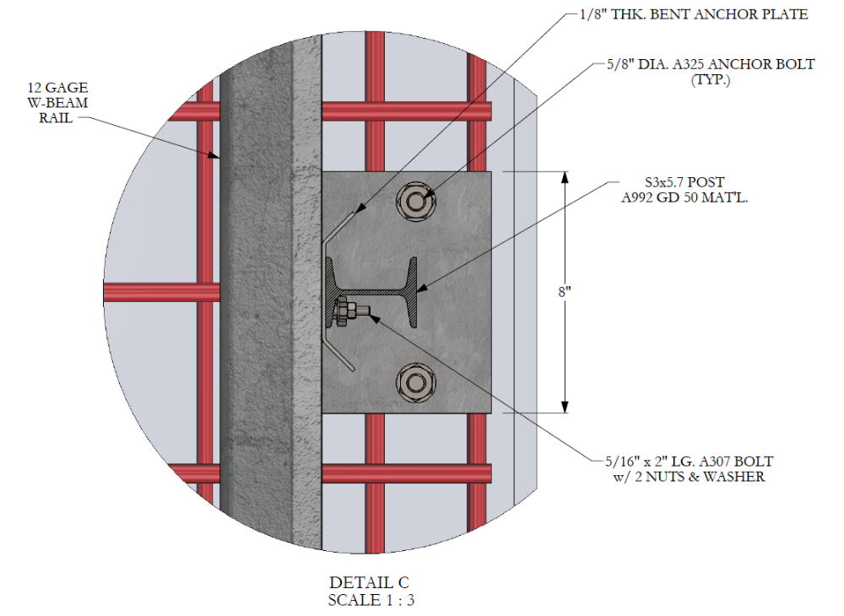

Slide 12
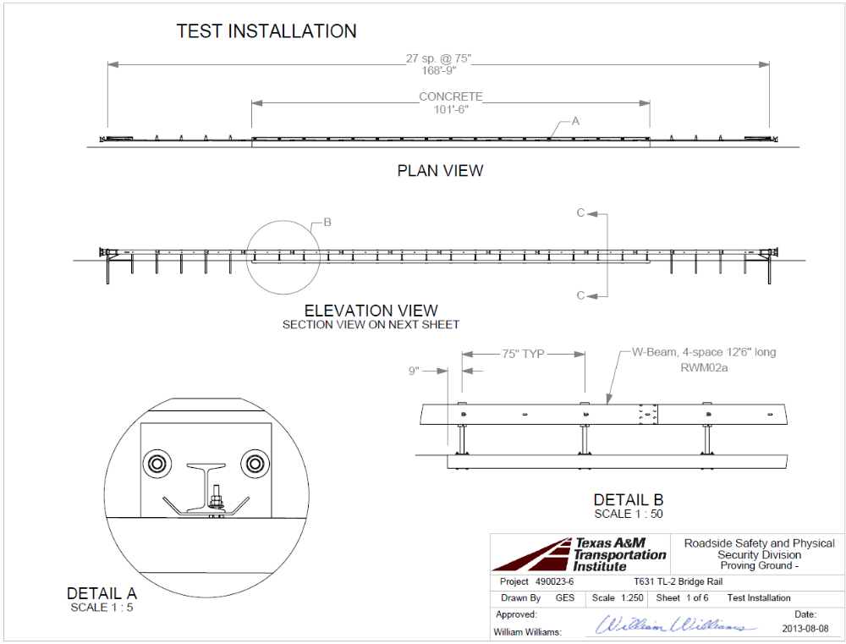

Slide 13
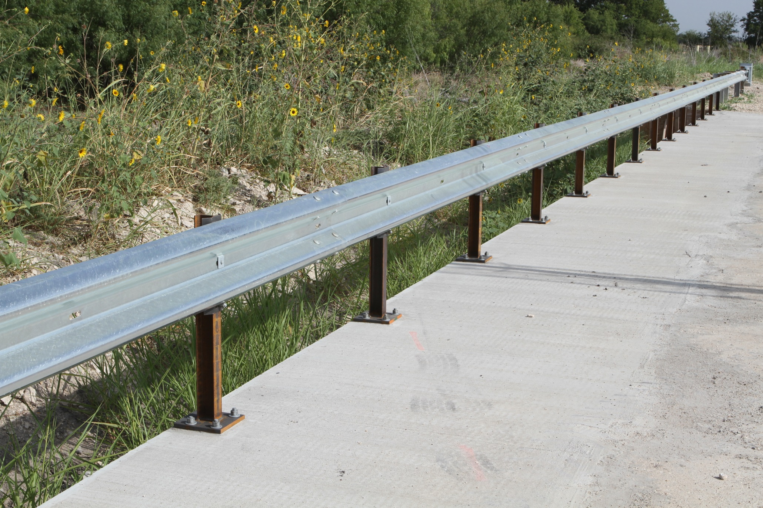
Photos of the Test Installation

Slide 14
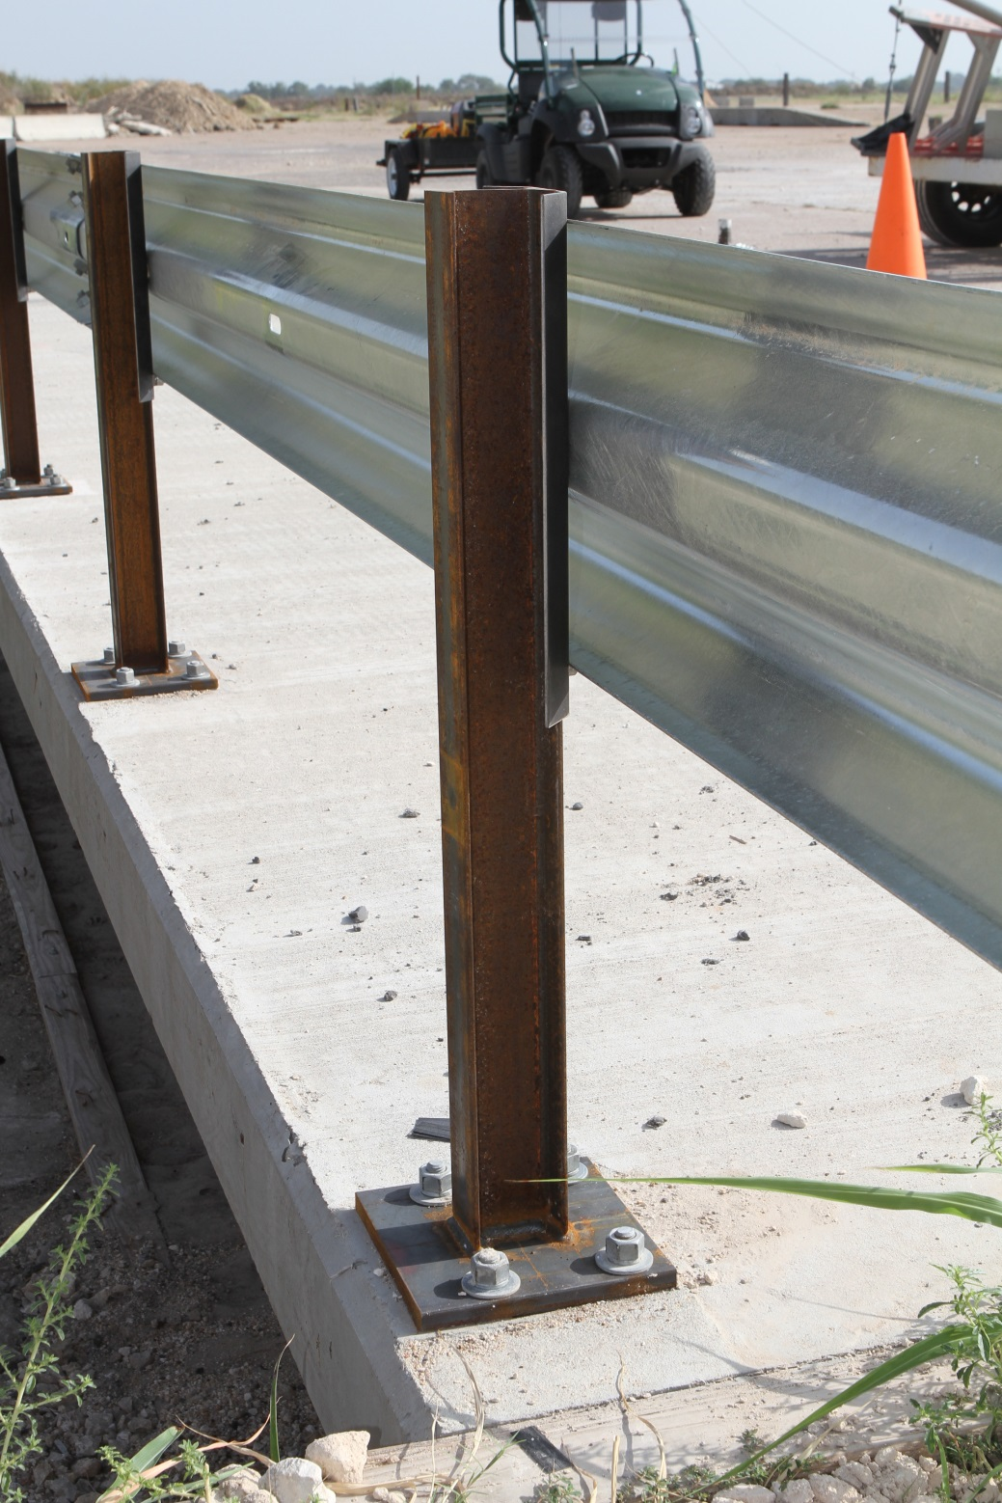
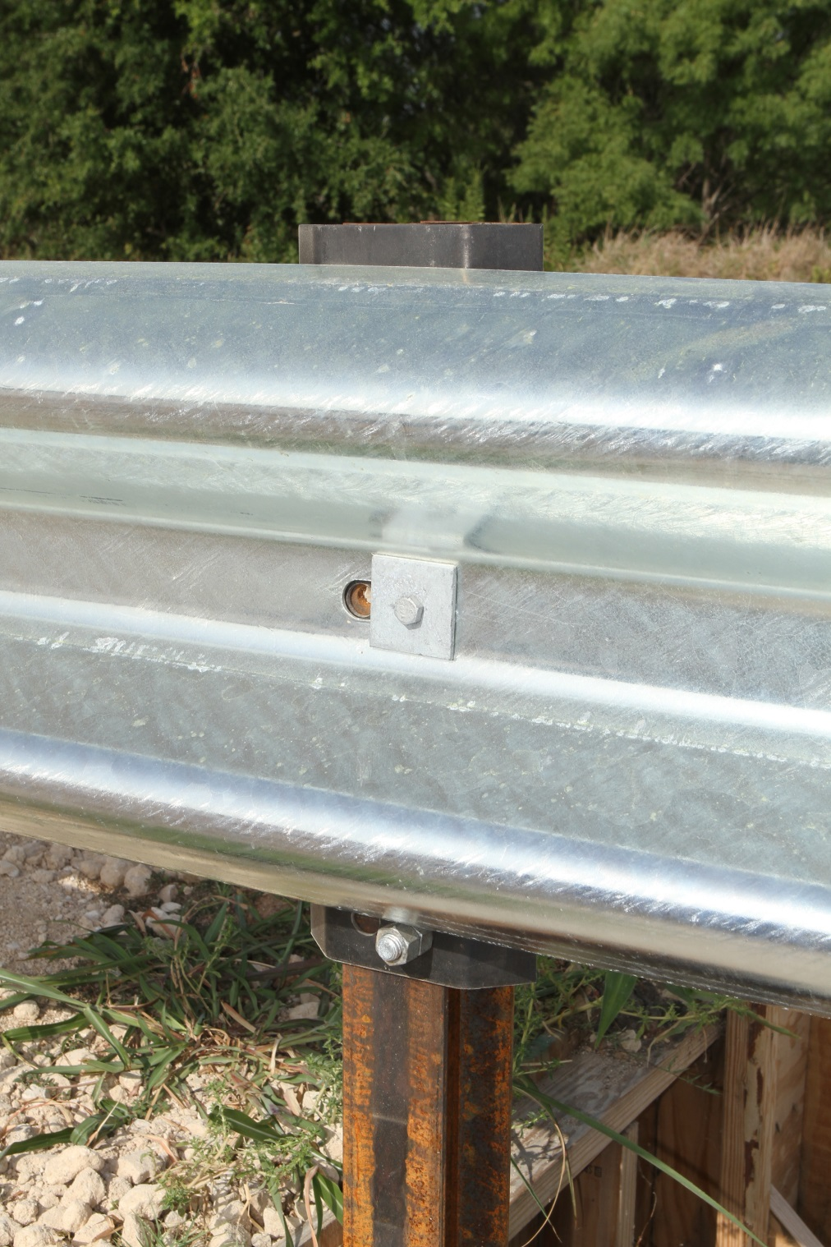

Slide 15
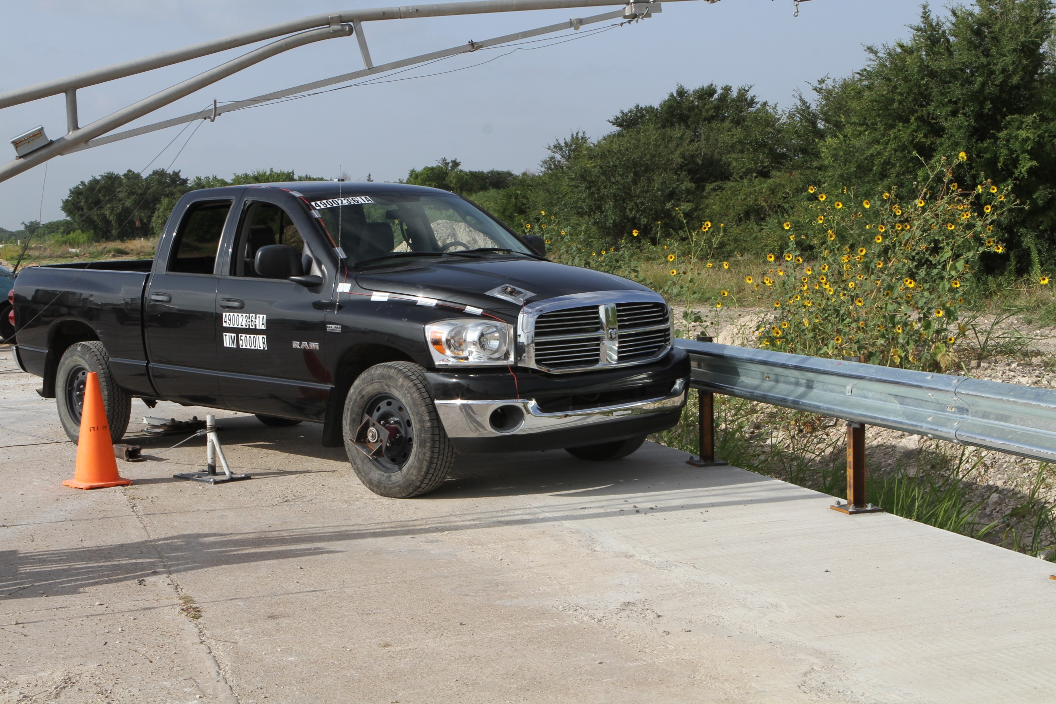

Slide 16
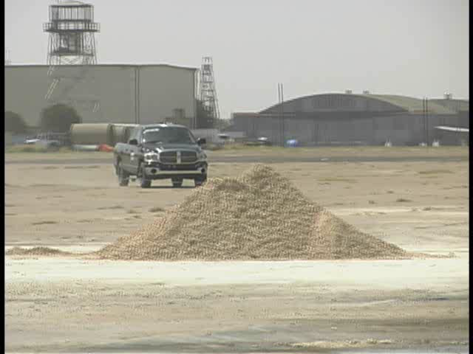
Performed MASH Test 2-11 on August 8, 2013
Test Parameters
  Test Designation: MASH 2-11
  Test Vehicle: 2270P
  Impact Speed: 44.9 mph
  Impact angle: 25.0 deg
  Impact Location: 12 ft upstream
  of centerline Post 13
Test Results (PASS)
  Met all the risk criteria of MASH
  Test 2-11
  Rideddown Accel. 10 g’s
  Occupant Impact Velocity 3.2 m/s

Slide 17
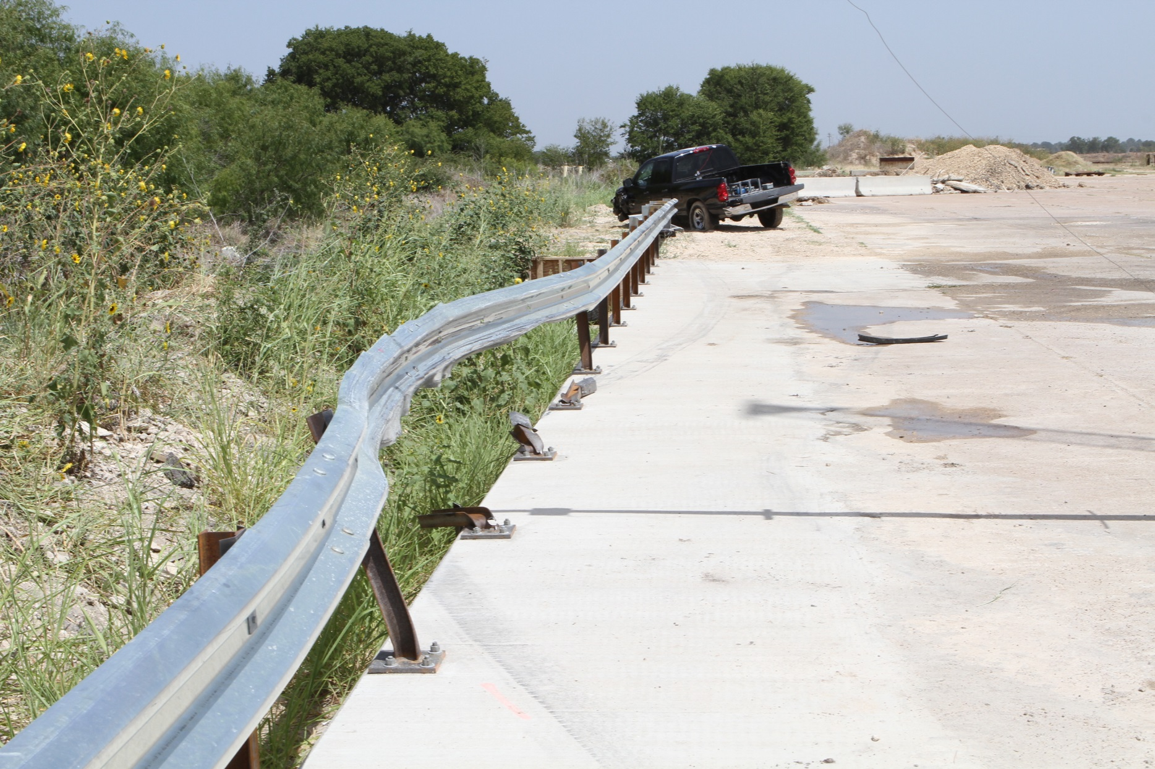
After Test Photos

Slide 18
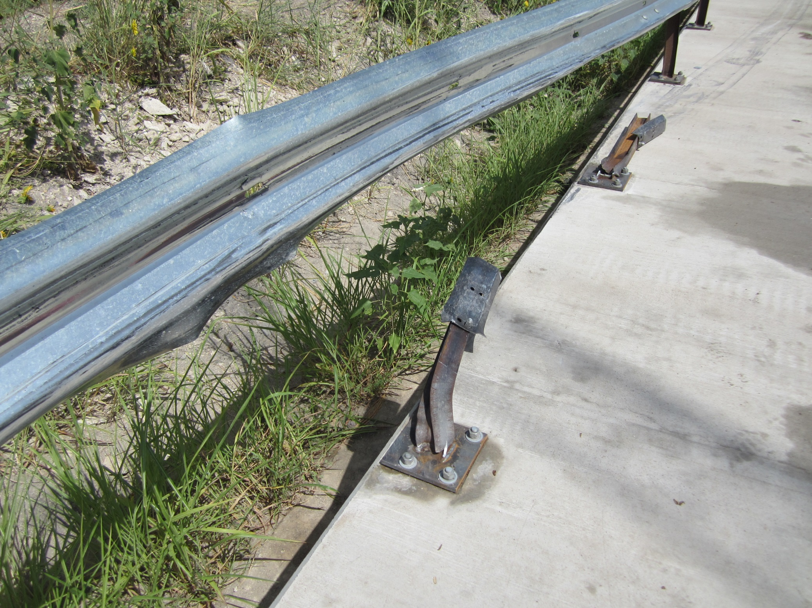

Slide 19
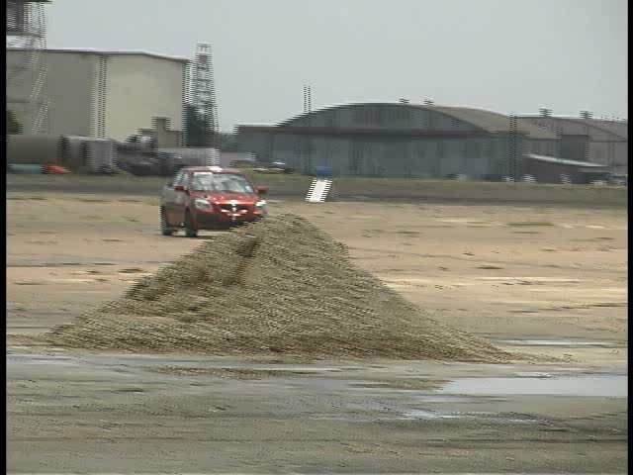
Performed MASH Test 2-10 on August 15, 2013
Test Parameters
  Test Designation: MASH 2-10
  Test Vehicle: 1100C
  Impact Speed: 43.8 mph
  Impact angle: 25.0 deg
  Impact Location: 6.7 ft upstream
  of centerline Post 10
Test Results (PASS)
  Met all the risk criteria of MASH
  Test 2-10
  Rideddown Accel. 6.7 g’s
  Occupant Impact Velocity 6.2 m/s

Slide 20
Conclusions & Recommendations
T631 Bridge Rail met all the performance requirements for MASH Test Level 2.
No deck damage was observed from either of the two tests performed.
Bolted bent back-up plates performed well.
Recommend the T631 be used for TL-2 application on TXDOT bridges.

Slide 21
Questions
William Williams, P.E.
w-williams@tamu.edu

